Slide 1



A Brief Introduction to SAGA
Building and Installing

Slide 2
How is SAGA Used?
SAGA is used to develop applications that are distributed by definition:
Simple extensions of “localized applications” (eg scripting)
MW applications, workers submitted to >8 back-ends
Novel Distributed Programming Models (eg Rep-Exch)
SAGA: Build tools and implement abstractions that enable the execution of applications over distributed resources, without modifying the applications
Eg. Infrastructure Independent Pilot-Jobs
SAGA: To provide uniform access layers to heterogeneous CI
Uniform access to EGI (ARC, gLite, Globus and Unicore/BES)
Simplify the building of tools and Gateways

Slide 3
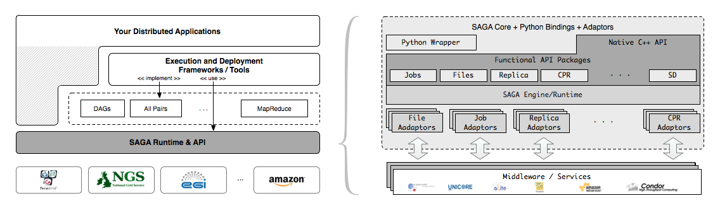
SAGA: The BigPicture

Slide 4
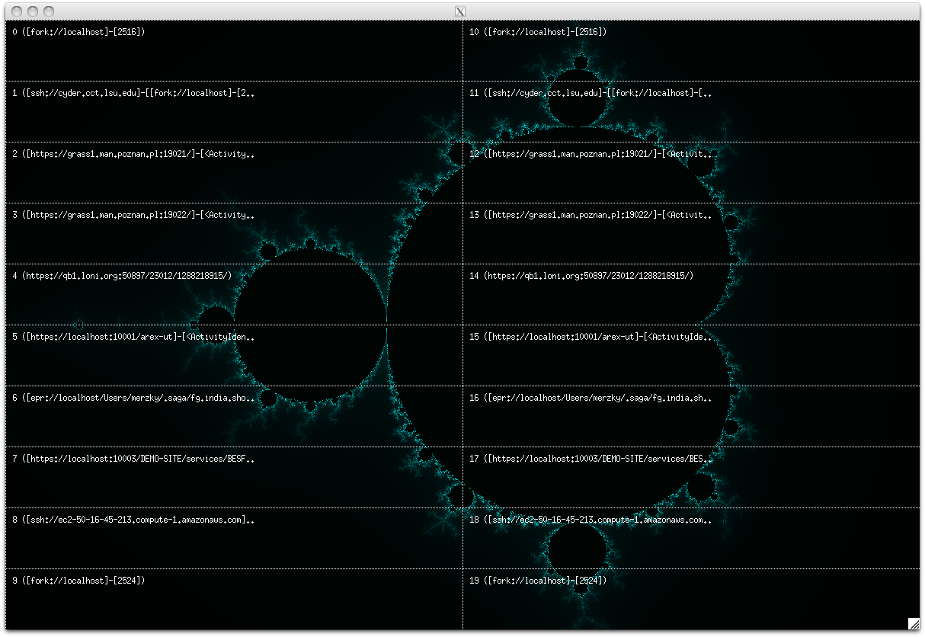
1. Develop distributed applications

Slide 5
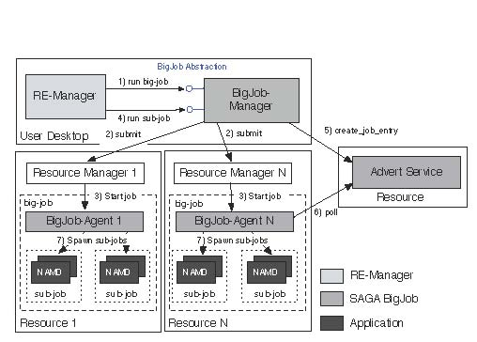
Distributed Replica-Exchange

Slide 6
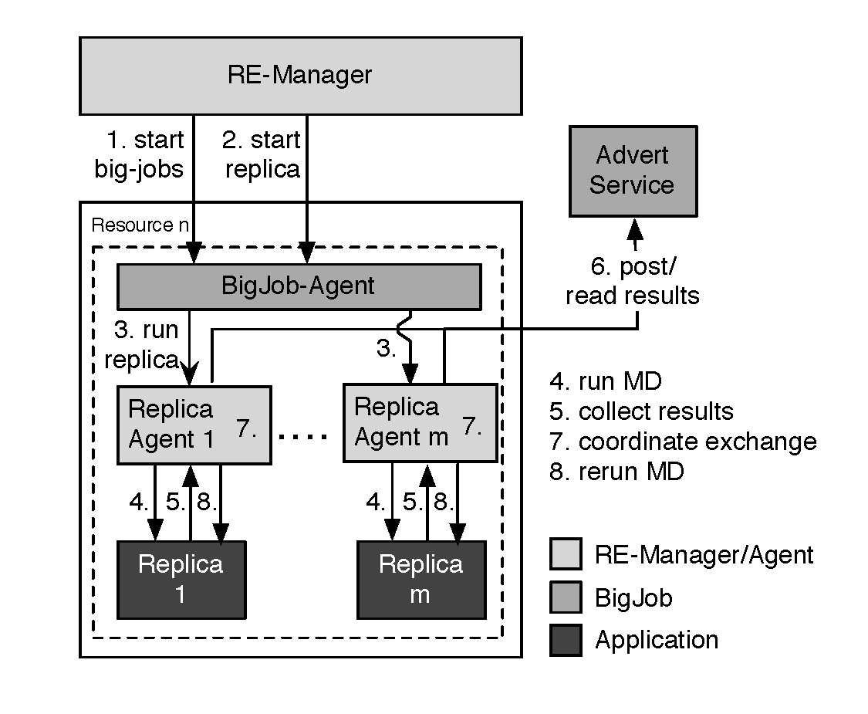
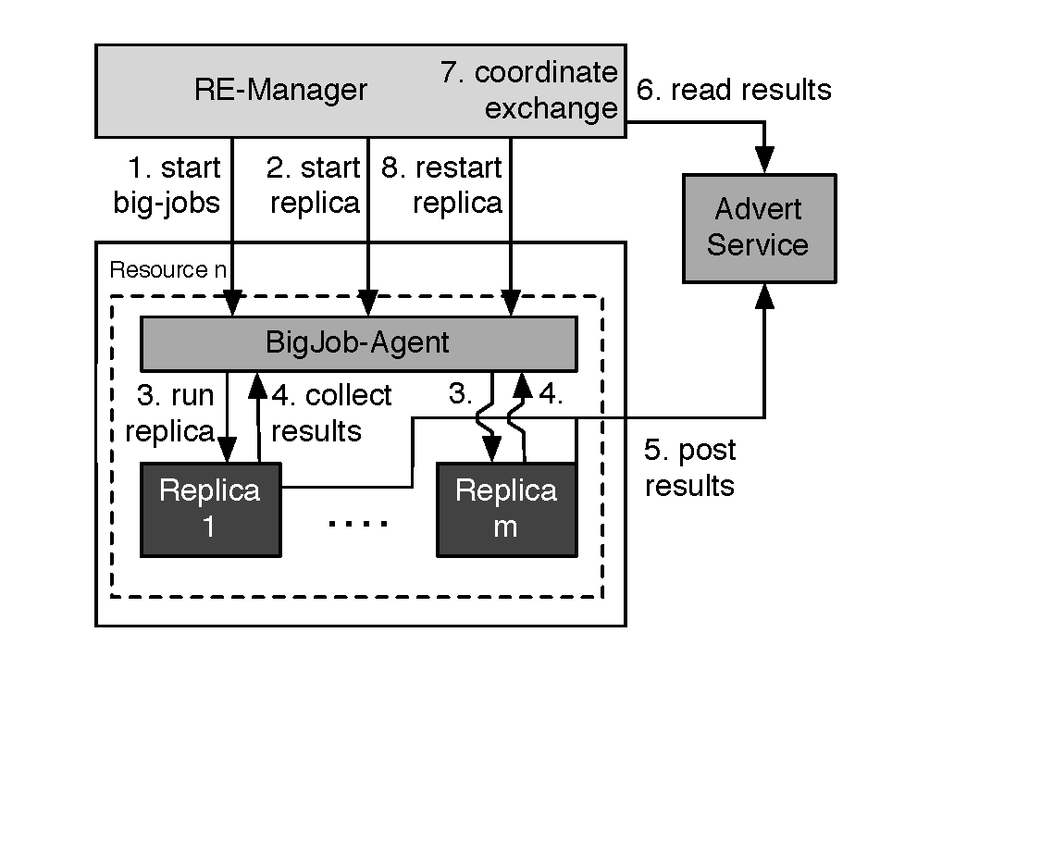
Distributed Coordination of Replicas
Decentralised
Centralised

Slide 7
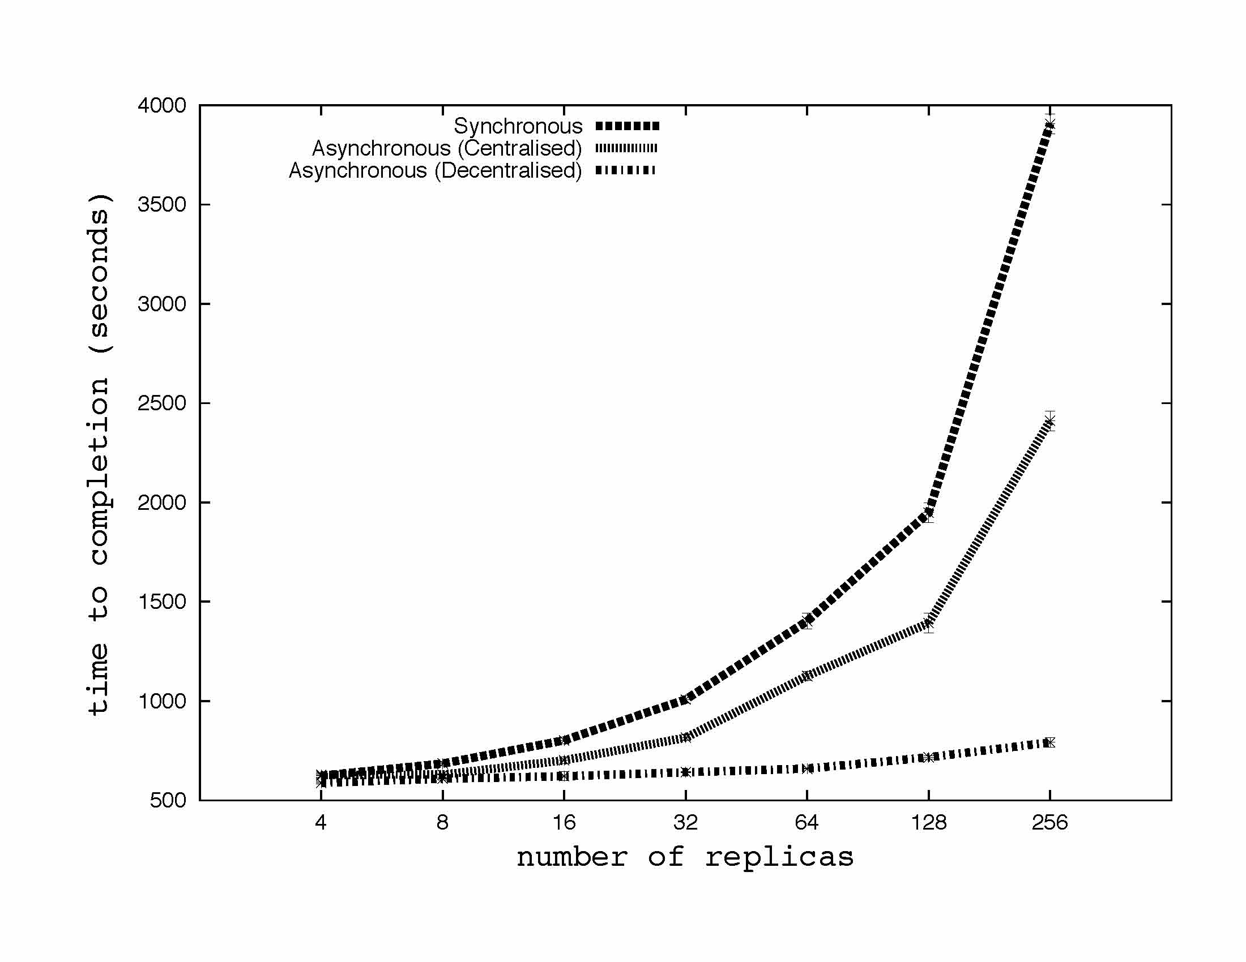
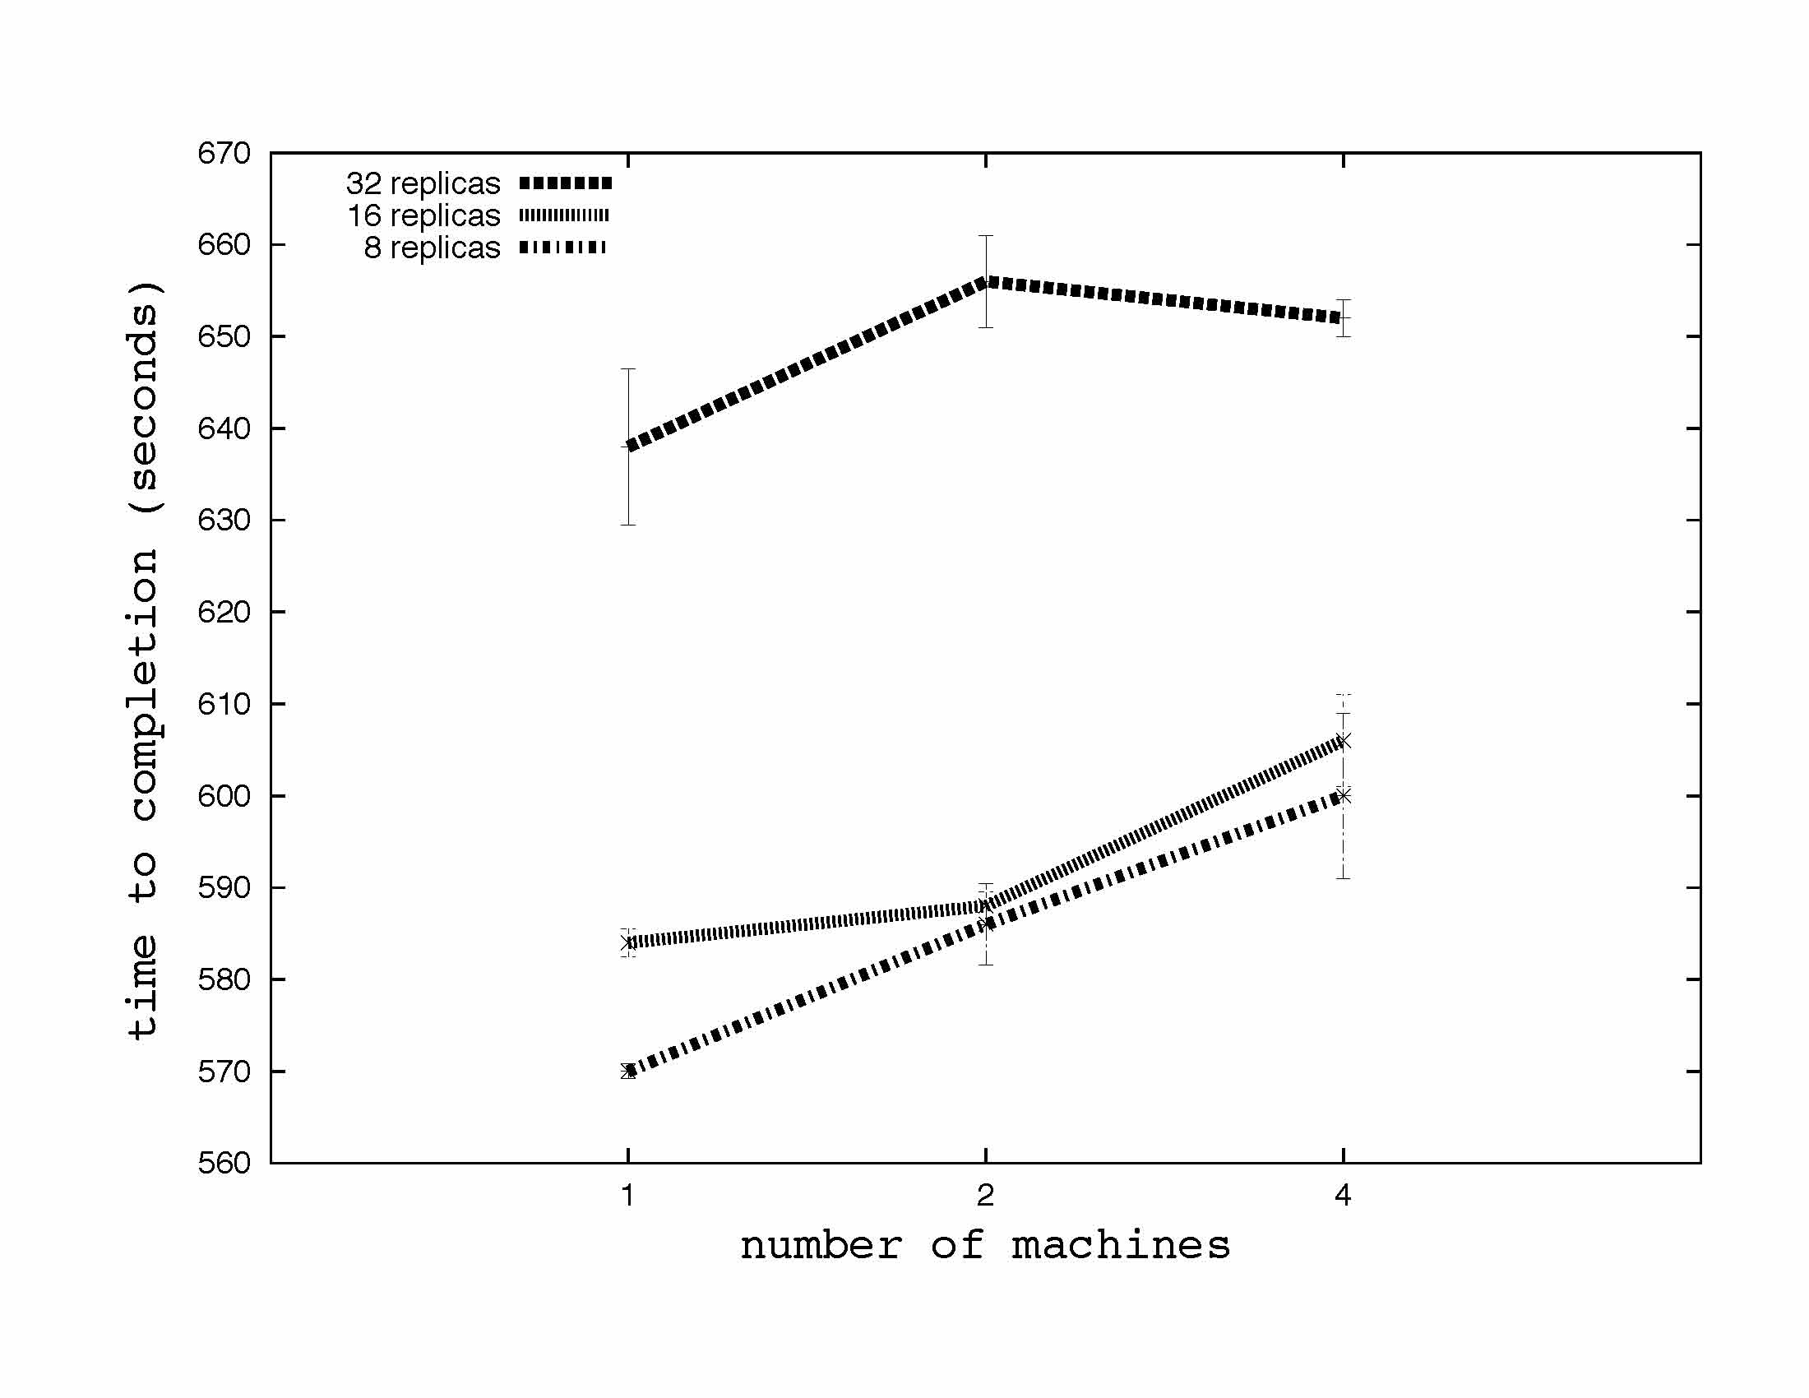
Understanding Distributed Programming Models Scale-Up and Scale-Out
Scale-Out
Scale-Up

Slide 8
2. Tools for Effective Distributed Execution

Slide 9
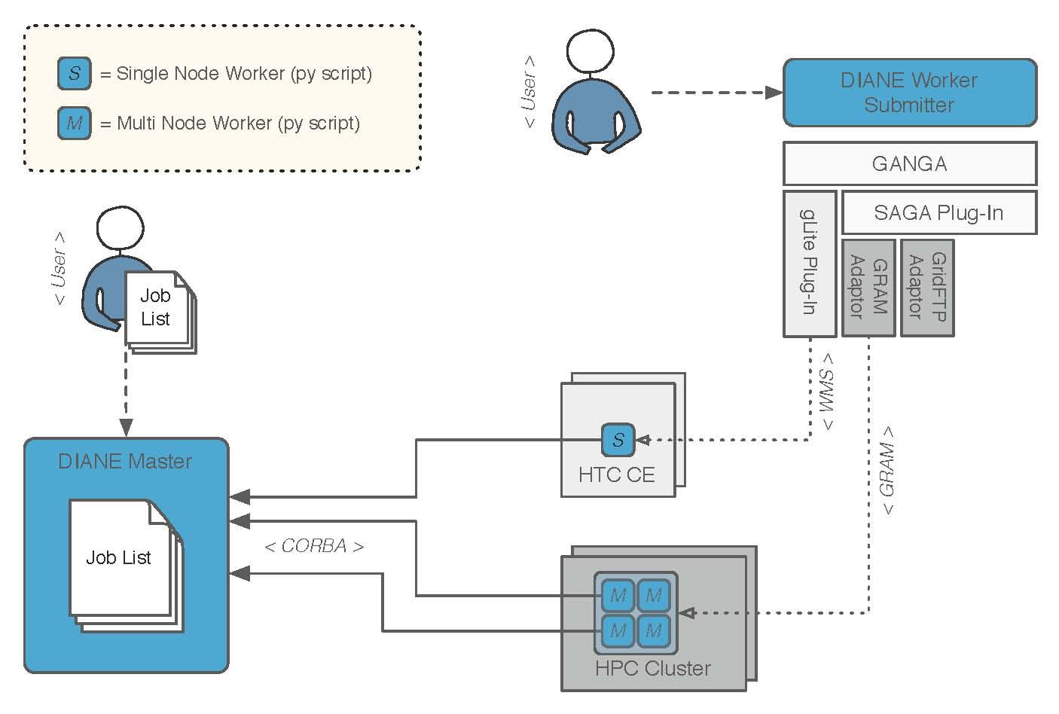
Extensible Tools: DIANE-GANGA-SAGA Extend DIANE to Globus Grids using SAGA

Slide 10
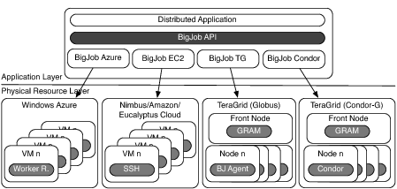
Tools for Effective Distributed Execution

Slide 11
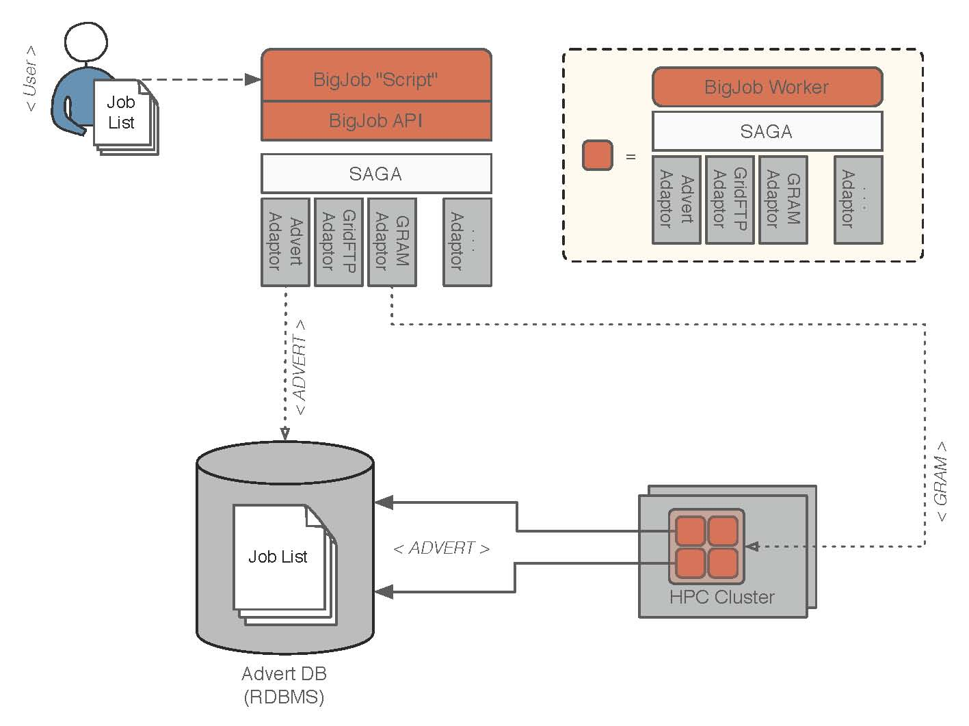
SAGA-based Pilot-Job Interface

Slide 12
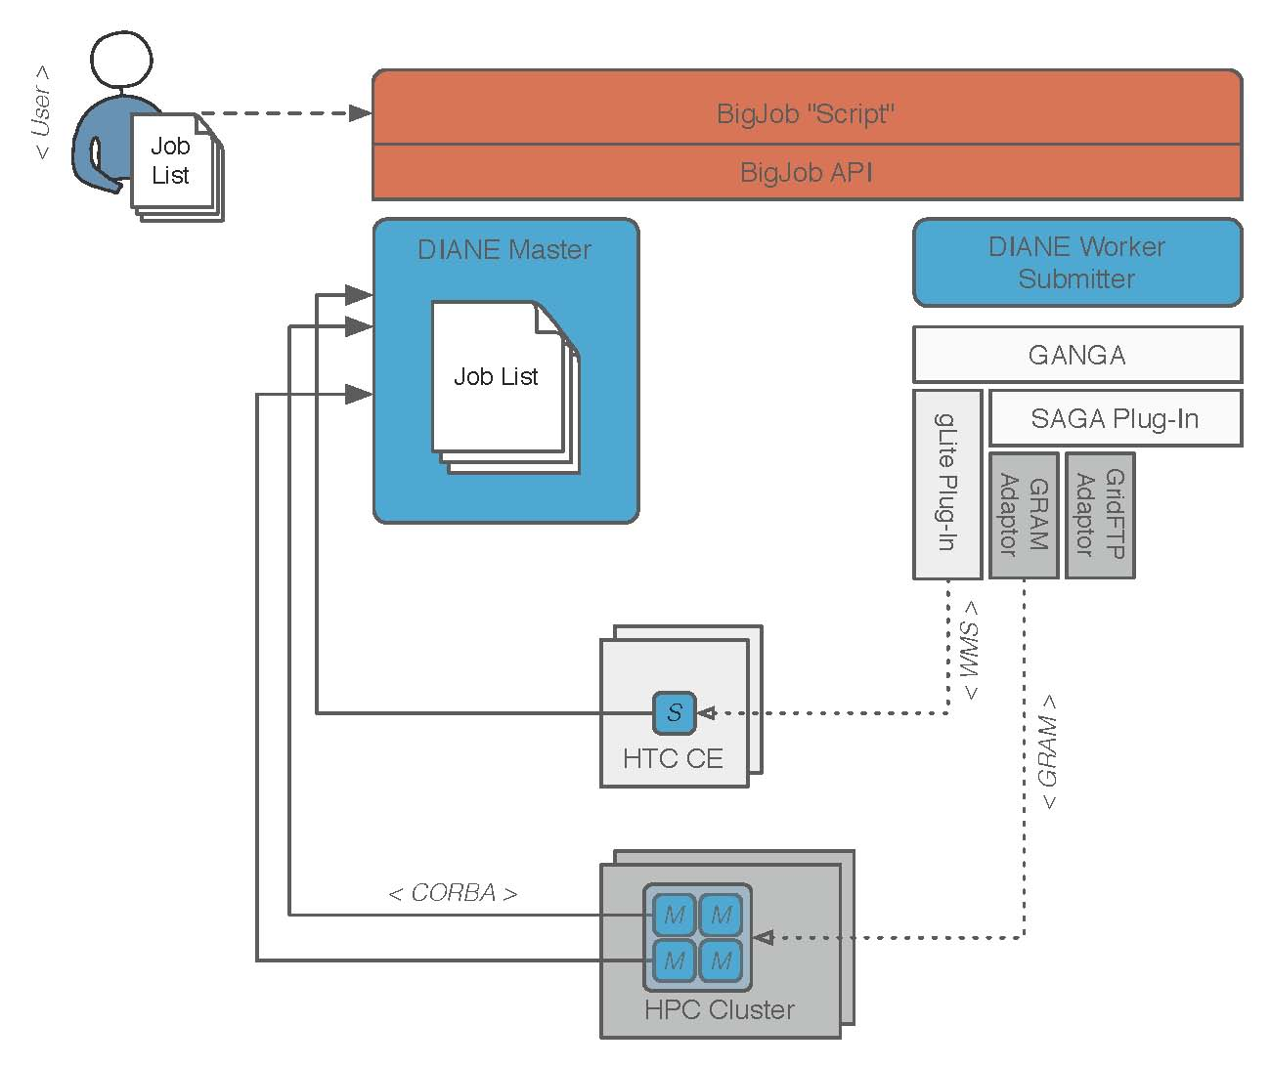
Extensible Tools: DIANE-GANGA-SAGA Extend DIANE to HPC using SAGA-BigJob

Slide 13
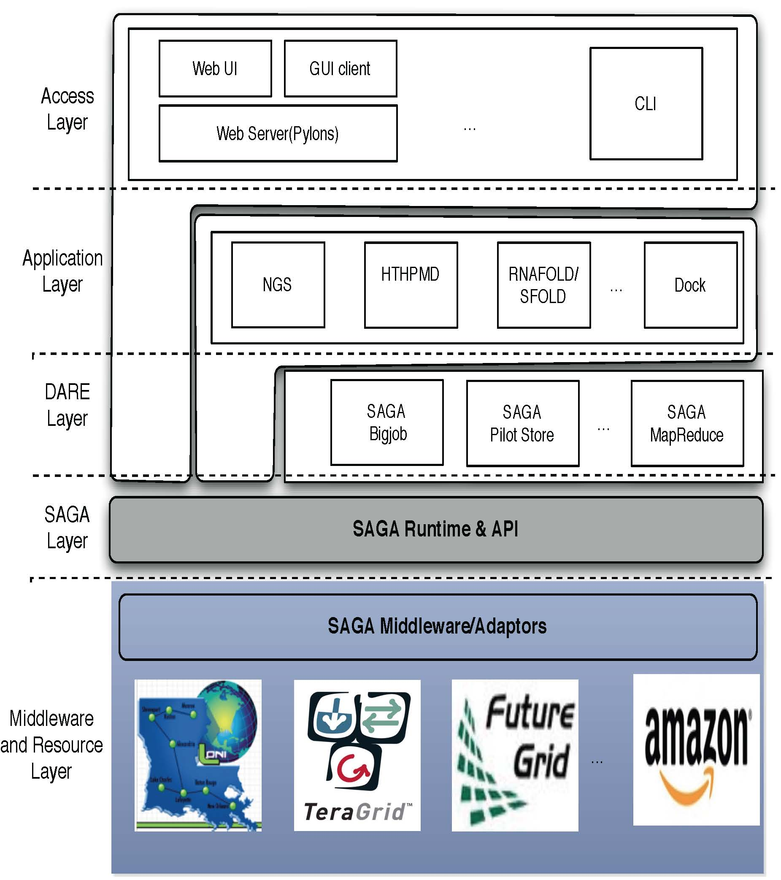
DARE: Dynamic Adaptive Runtime Environment

Slide 14
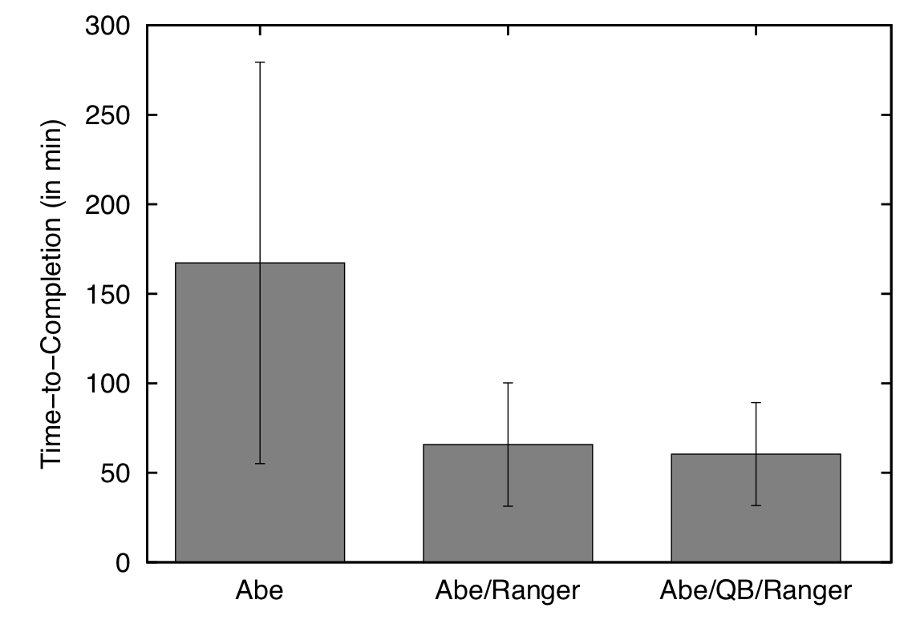
Distributed Adaptive Replica Exchange (DARE) Multiple Pilot-Jobs on the “Distributed” TeraGrid
Ability to dynamically add HPC resources. On TG:
Innovations in Distributed Algorithms:
Variants of RE: Sync (local) vs async (distr.)

Slide 15
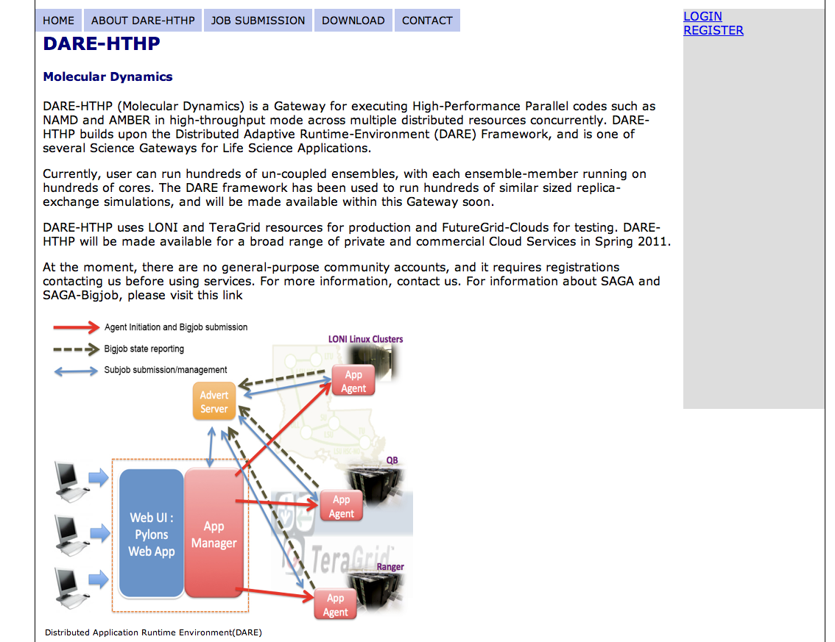
DARE-HTHP Molecular Dynamics
http://cyder.cct.lsu.edu/dare-hthp

Slide 16
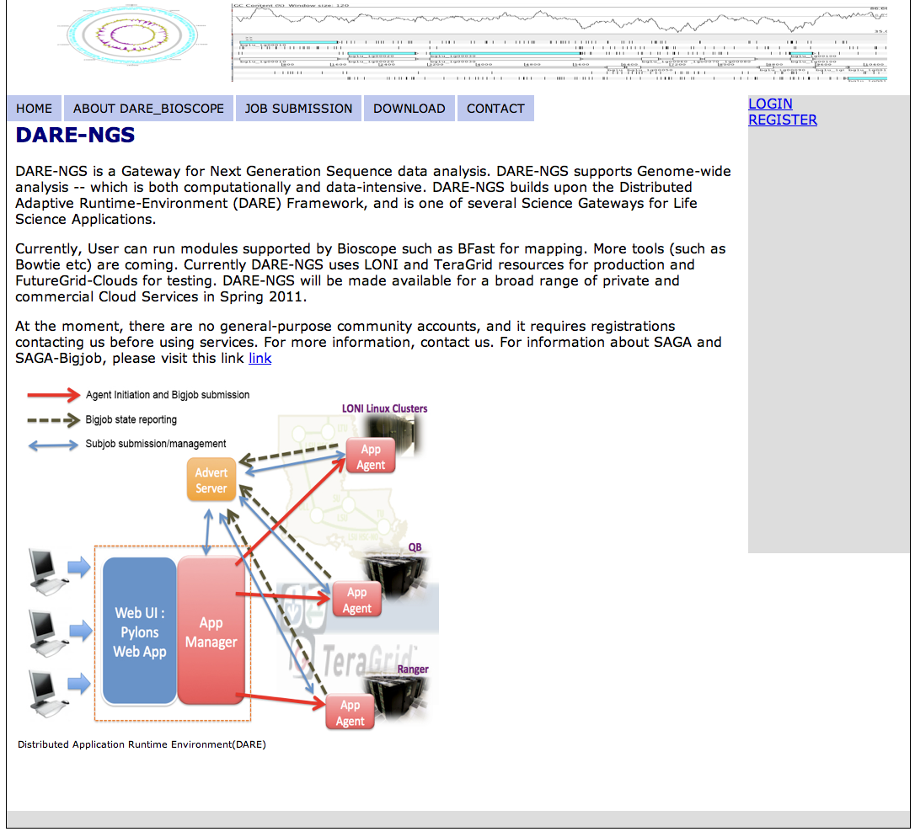
DARE-NGS
http://cyder.cct.lsu.edu/dare-ngs

Slide 17
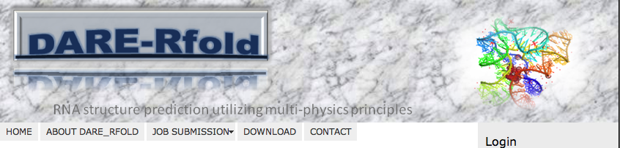
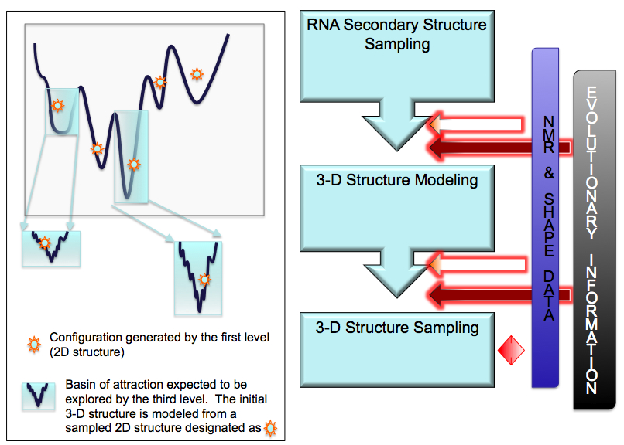
DARE: HT-HPC, NGS, DOCK, Rfold/Sfold,
DARE-Gateway:
Integrated, Extensible
Balanced: Scale-Up and Scale-out to
DARE-RFOLD, DOCK, Bioscope (NG Sequence Data), STMD (Molecular Dynamics)

Slide 18
Java-based Python SAGA wrapper
C Python
Jython
a user application
a user application
Python Bindings for SAGA
SAGA-C++Py
?
JPySAGA
JySAGA
legacy python bind.
Boost wrapper
C++ Bindings for SAGA
Java Bindings for SAGA
SAGA-C++
JSAGA
Java SAGA
Java GAT

Slide 19
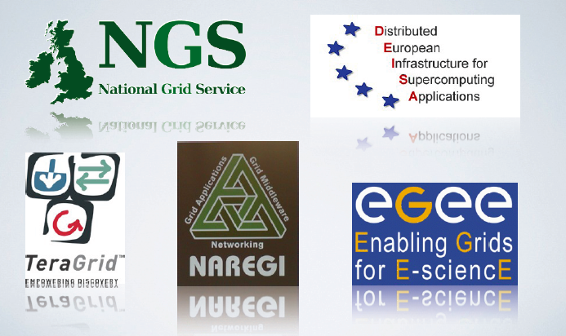

3. Provides uniform access layers to heterogeneous CI

Slide 20
All material from this tutorial can be found at: https://svn.cct.lsu.edu/repos/saga-projects/tutorial/EGI-2011

